Slide 1
AUTONOMOUS DRIVING CAR
BY: KOUSHIK.G.S(URK23EC6017)
DHANUSS(URK23EC3011)
NITIN.V.R(URK23EC6024)

Slide 2
Introduction to Autonomous Driving Car
This autonomous driving car project aims to develop a cutting-edge self-driving vehicle that can navigate urban environments safely and efficiently. The project will explore the latest advancements in sensor technology, software algorithms, and integrated systems to create a truly intelligent and autonomous car.

Slide 3
Project Objectives and Scope
Key Objectives
Develop a fully autonomous driving system that can handle complex urban driving scenarios with minimal human intervention.
Scope of Work
The project will cover sensor integration, advanced computer vision, decision-making algorithms, and extensive real-world testing and validation.
Deliverables
A prototype autonomous driving car that demonstrates reliable and safe navigation in diverse traffic conditions.

Slide 4
Key Technologies
Sensor Fusion
Integrating sensors, like ultrasonic sensor to create a comprehensive 180-degree understanding of the vehicle's surroundings.
Advanced Computer Vision
Leveraging deep learning algorithms for object detection, classification, and tracking to enable reliable perception and scene understanding.
Predictive Algorithms
Developing sophisticated decision-making algorithms that can anticipate and respond to the behavior of other vehicles and pedestrians.
Connectivity and Simulation
Enabling vehicle-to-vehicle and vehicle-to-infrastructure communication, as well as comprehensive virtual testing in simulated environments.

Slide 5
Sensor Integration and Data Processing
Sensor Fusion
Combining data from sensors, like ultrasonic sensor to create a comprehensive understanding of the vehicle's surroundings.
Real-time Processing
Deploying high-performance computing platforms like Arduino UNO to process sensor data and make split-second decisions in real-time.
Machine Learning Integration
Integrating advanced machine learning models to enable robust object detection, classification, and tracking capabilities.

Slide 6
Testing and Validation Procedures
Simulation Testing
Extensive virtual testing in realistic simulated environments to evaluate the system's performance and safety.
Closed-course Trials
Rigorous testing on closed test tracks to validate the system's functionality under controlled conditions.
Real-world Validation
Gradual introduction of the autonomous vehicles into real-world driving scenarios to assess their performance in complex, unpredictable environments.

Slide 7
Conclusion and Reference
This autonomous driving car project represents a significant step forward in the development of intelligent, self-driving vehicles. By leveraging cutting-edge technologies and rigorous testing procedures, the project aims to create a safe, reliable, and efficient autonomous driving system that can revolutionize the future of transportation.
REFFERENCE:- Autonomous Vehicle Technology website.

Slide 8
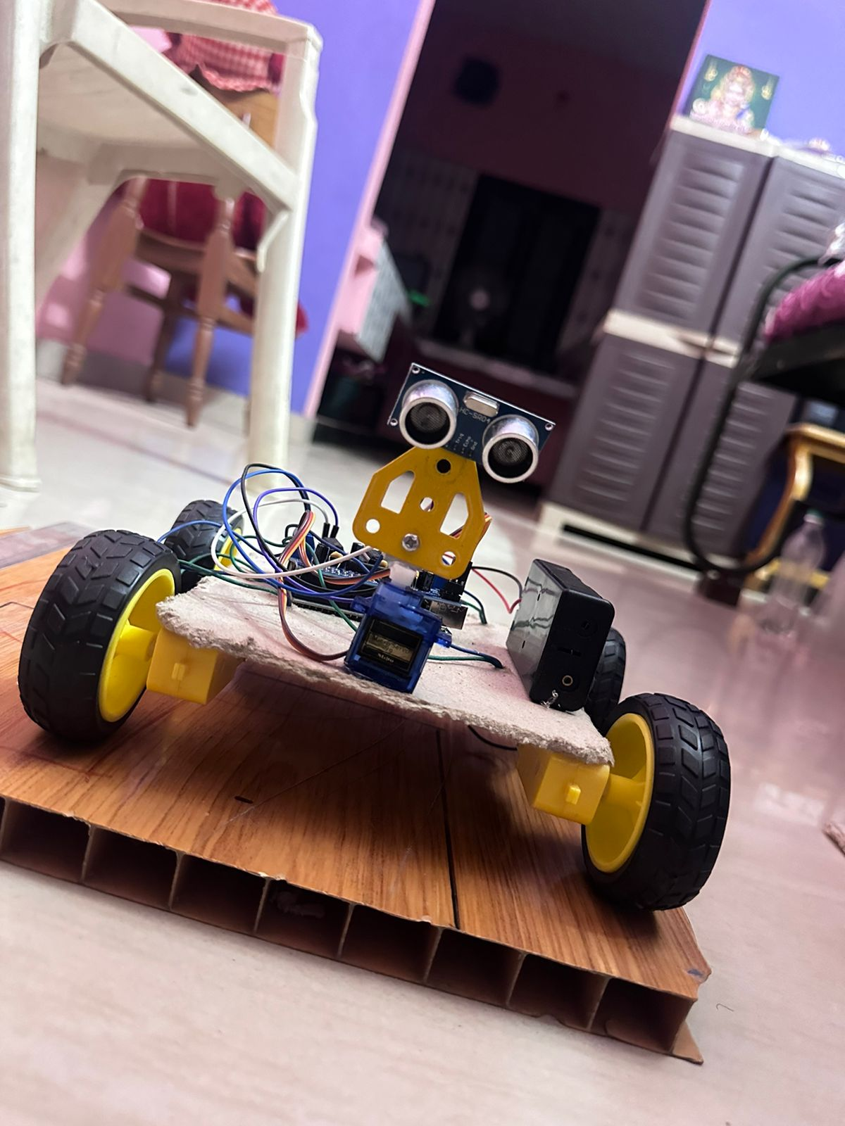
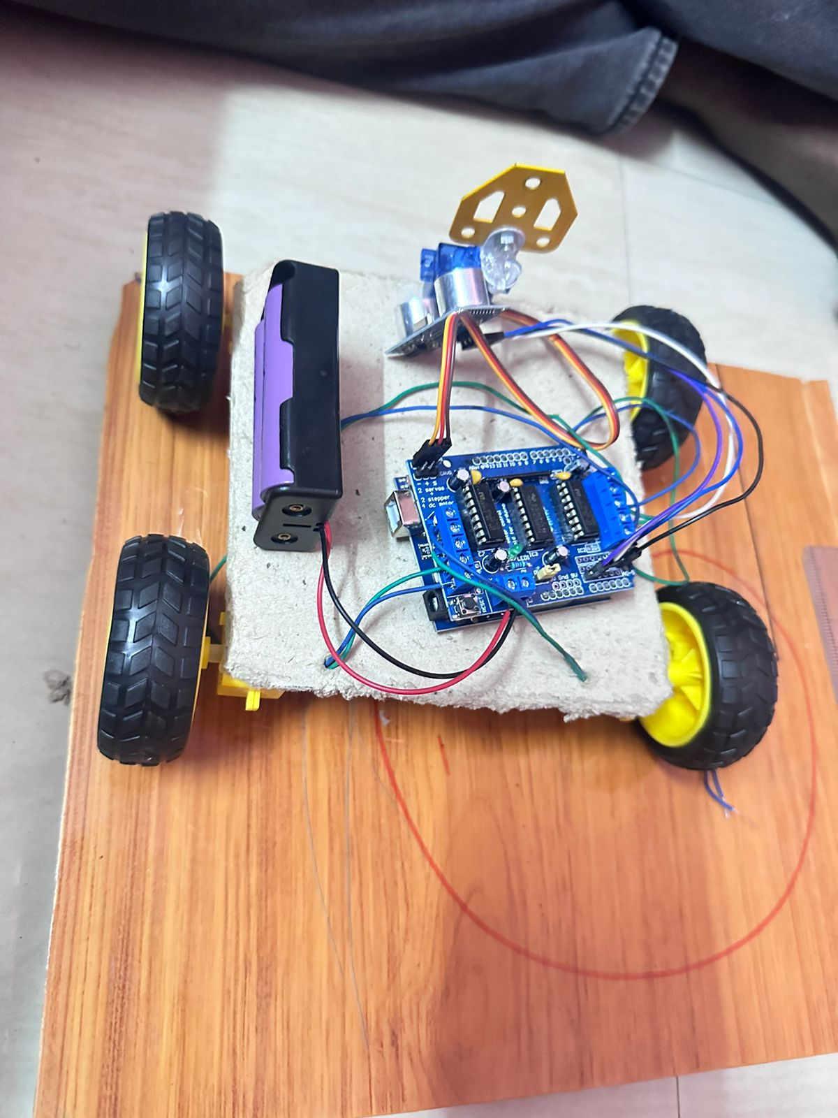
IMAGES

Slide 9


